Slide 1

PHP
CHAPTER 2 – PHP WEB SERVER

Slide 2





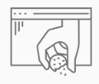

CHAPTER 2
WEB SERVER
CLIENT
REQUEST
CHAPTER 2
WEB
FORMS
EXECUTE PHP CODE
MANUPULATE
DATA
RESPONSE
WEB COOKIES
GENERATE HTML

Slide 3

OBJECTIVES FOR TODAY
What is a URL, an IP address, a port ?
How computers can interact in a network ?
What is HTTP ?
What is a web server ?
How to run a web server on your computer to serve your website ?

Slide 4
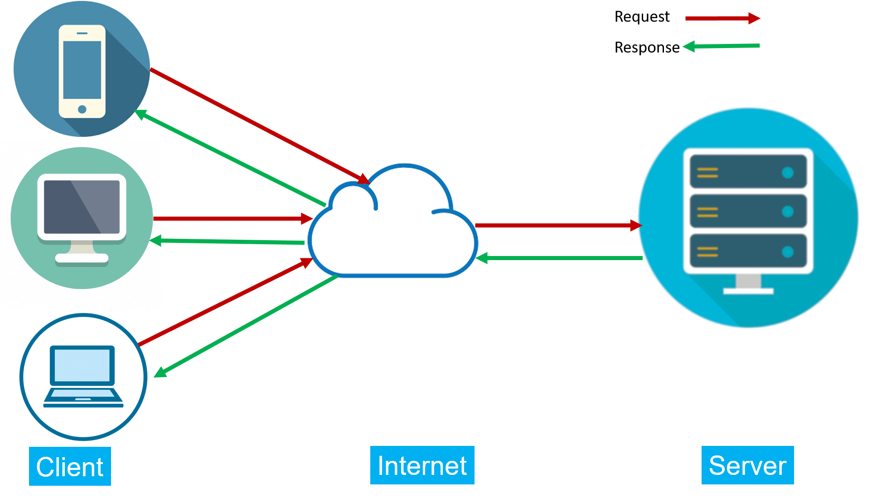
How to communicate between server and clients ?

Slide 5
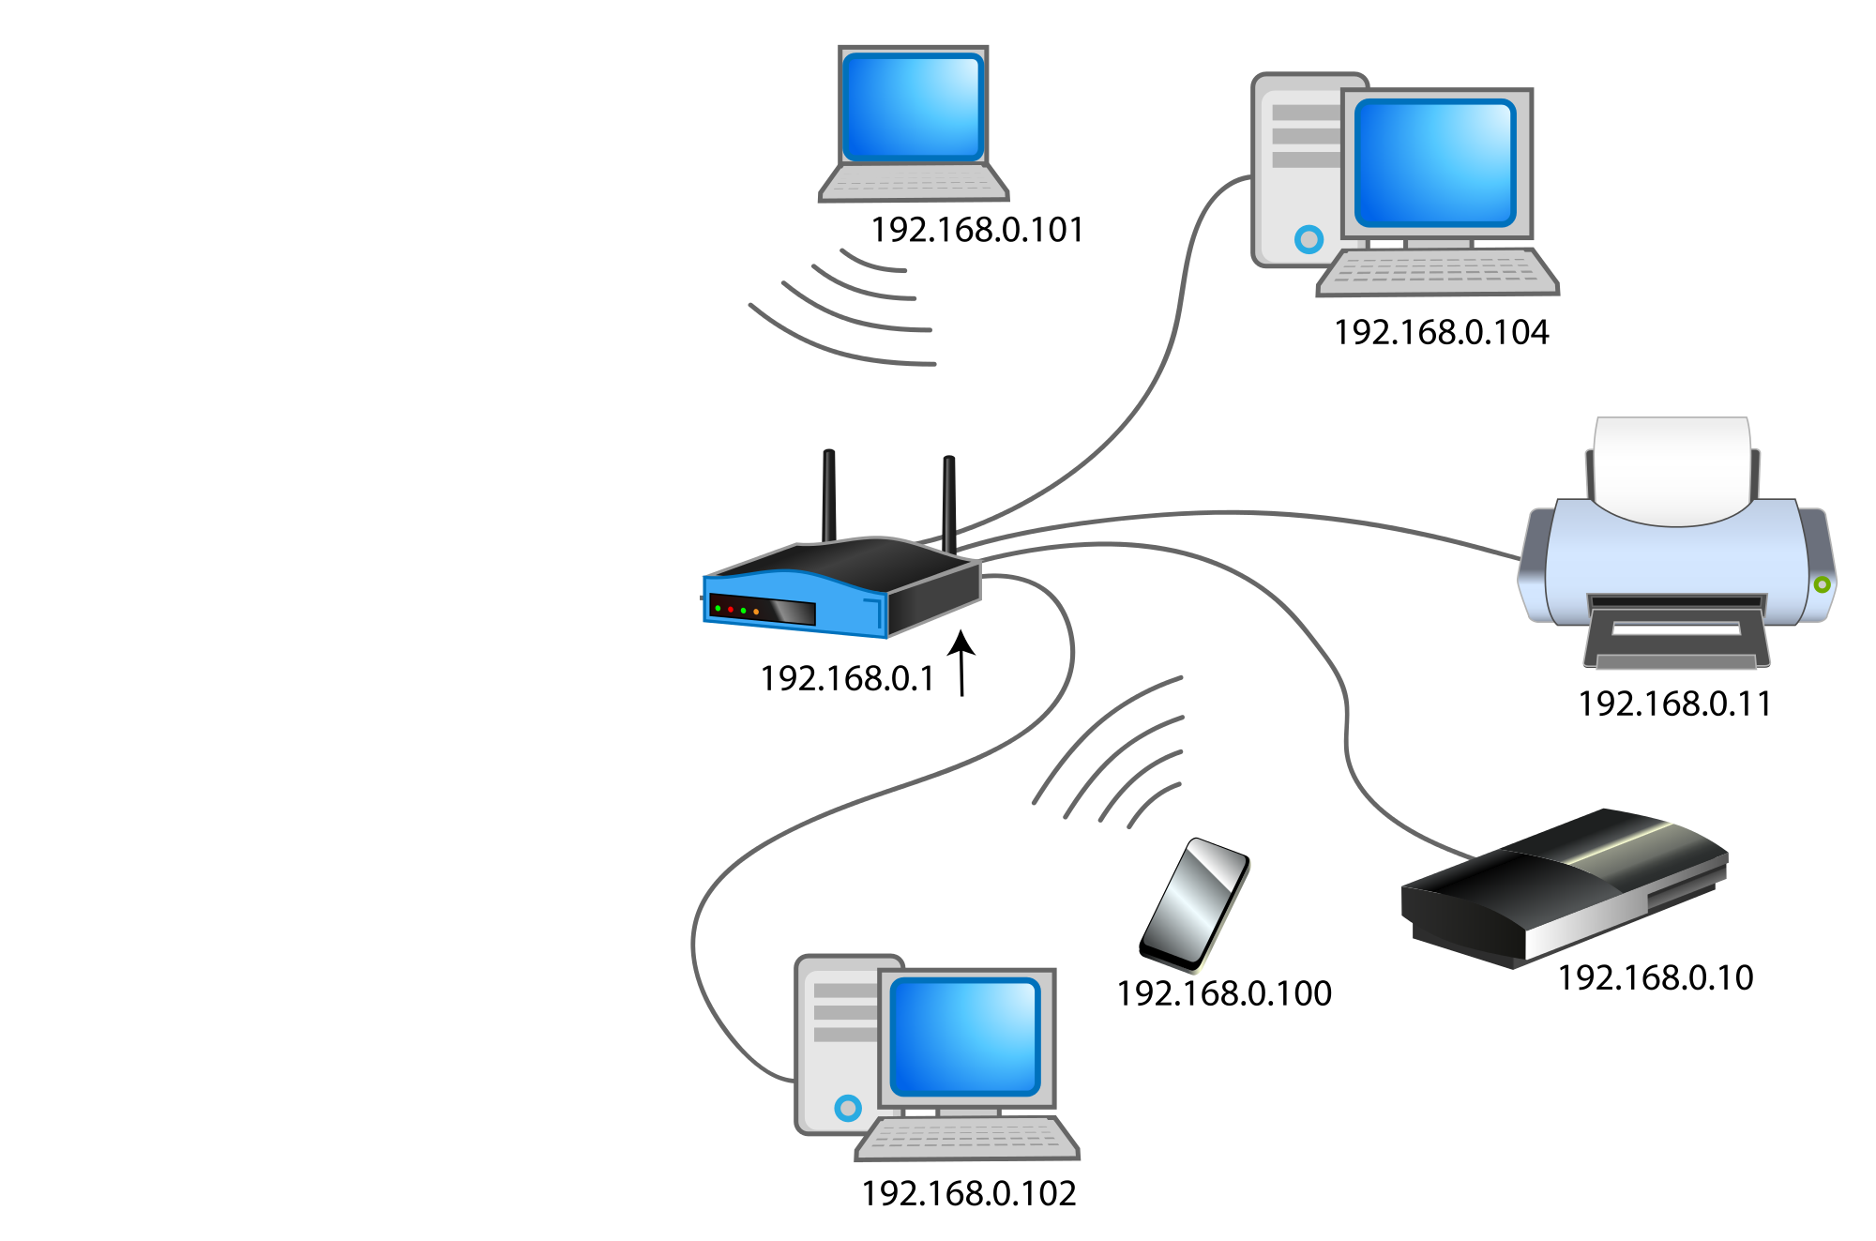
What is an IP address ?
An IP address refers to a unique number assigned to a device when connected to the Internet.
Run ipconfig to find your IP @ !

Slide 6


What is an PORT ?
A computer can run many softwares at the same time
To make the difference, each service use a different port of the device
5000
80
5001
EXAMPLES
HTTP = port 80,
HTTPS = port 443,
5000
25
5

Slide 7

2 steps to access to a service
IP of the computer
PORT of the service
192.168.102
WEB SERVER
PORT: 3000
192.168.102:3000
FTP SERVER
PORT: 999
MAIL SERVER
PORT: 25

Slide 8
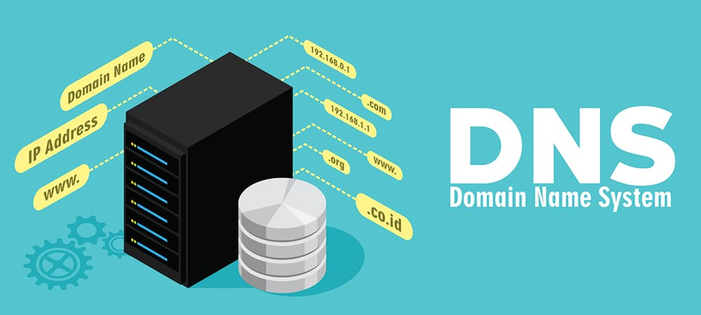
What is a DNS?
A DNS can provide an IP ADDRESS from a DOMAIN NAME

Slide 9
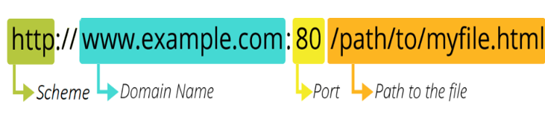
What is a URL ?
A URL is the address to a file in a network
The ULR is composed of 4 parts:
The protocol : http , https, ftp…
The IP or Domain Name
The port
The file path

Slide 10
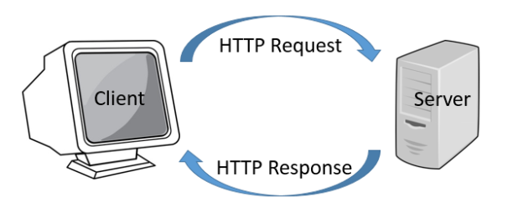
What is the HTTP protocol ?
HTTP is the protocol used to manage requests and responses between a client and a server

Slide 11
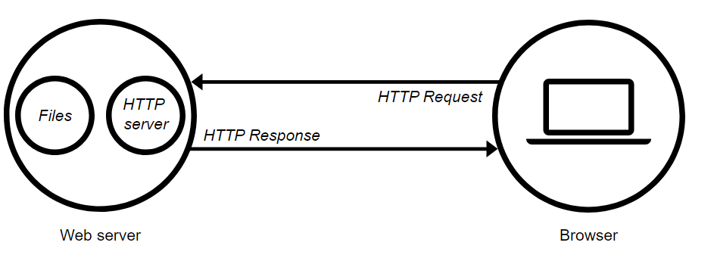
What is a HTTP server ?
A HTTP server is a computer that can respond to HTTP requests
A Client requests a file
HTTP server accepts the request
HTTP server return a status

Slide 12


Static VS Dynamic web servers
STATIC
DYNAMIC
+
PHP INTERPRETER
PHP interpreter generates a HTML file from the PHP file r

Slide 13


EXAMPLE !!

Slide 14

Bob wants to visit to facebok.com
BOB
192.168.0.2
This is BOB IP ADDRESS
192.168.0.13
This is FACEBOOK IP ADDRESS
BOB is working on GOOGLE CHROME

Slide 15
Bob wants to visit to facebok.com
BOB
192.168.0.2
192.168.0.13
www.facebook.com

Slide 16
The URL is converted to an IP address
BOB
192.168.0.2
192.168.0.13
www.facebook.com
192.168.0.13
DNS

Slide 17

But which service to call in the server ?
BOB
192.168.0.2
192.168.0.13
www.facebook.com
WEB SERVER
192.168.0.13
DNS
FTP SERVER
MAIL SERVER

Slide 18
All services have a PORT number assigned
BOB
192.168.0.2
192.168.0.13
192.168.0.13: 80
www.facebook.com
WEB SERVER : 80
DNS
FTP SERVER : 201
MAIL SERVER : 587

Slide 19
After RECEIVED, the server RESPONSES
BOB
192.168.0.2
192.168.0.13
192.168.0.13: 80
www.facebook.com
WEB SERVER : 80
DNS
FTP SERVER : 201
192.168.0.2: 9100
MAIL SERVER : 587
192.168.0.2:9100
IP of BOB
PORT for Chrome

